Slide 1
Fashion segmentation
Segmentation of fashion-related items

Slide 2

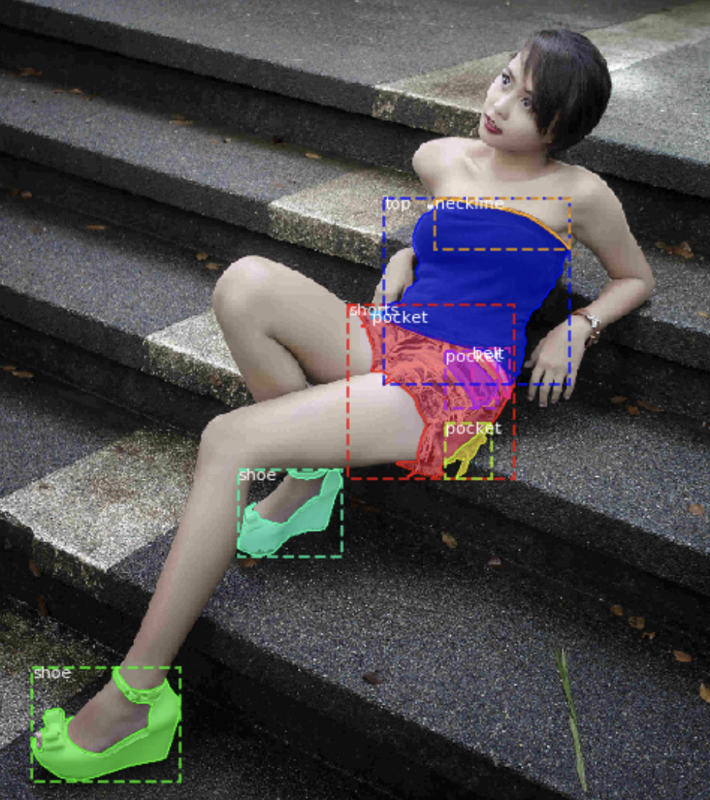
Fashion Segmentation
Objective
Segment fashion-related items
We chose Mask R-CNN
Data from Kaggle competition
Mask-RCNN is logical choice

Slide 3
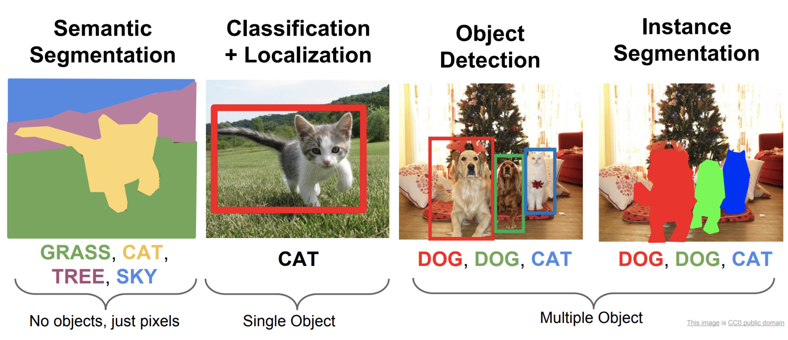
Segmentation and Classification
Alternative segmentation outputs
Different architectures produce different output.
The desired output will drive the selected architecture.

Slide 4
Instance Segmentation- Evolution
Mask R-CNN
Adds Instance Segmentation
3 outputs:
Classification
Bounding Box
Instance Segmentation
(near real-time 5fps)
https://arxiv.org/pdf/1703.06870.pdf
Object Detection Frameworks
Fast R-CNN
Single network for features, classification and bounding boxes
https://arxiv.org/pdf/1504.08083.pdf
Faster R-CNN
Added Region Proposal Network
(near real-time 5fps)
https://arxiv.org/pdf/1506.01497.pdf
R-CNN
Introduced concept of region proposals
https://arxiv.org/pdf/1311.2524.pdf
YOLACT
Real-time segmentation
(real-time 30fps)
https://arxiv.org/pdf/1904.02689.pdf
2014
2015
2016
2017
2018
2019
DeepMask
https://arxiv.org/pdf/1506.06204.pdf
SharpMask (.8FPS)
https://arxiv.org/pdf/1603.08695.pdf
https://blog.athelas.com/a-brief-history-of-cnns-in-image-segmentation-from-r-cnn-to-mask-r-cnn-34ea83205de4

Slide 5
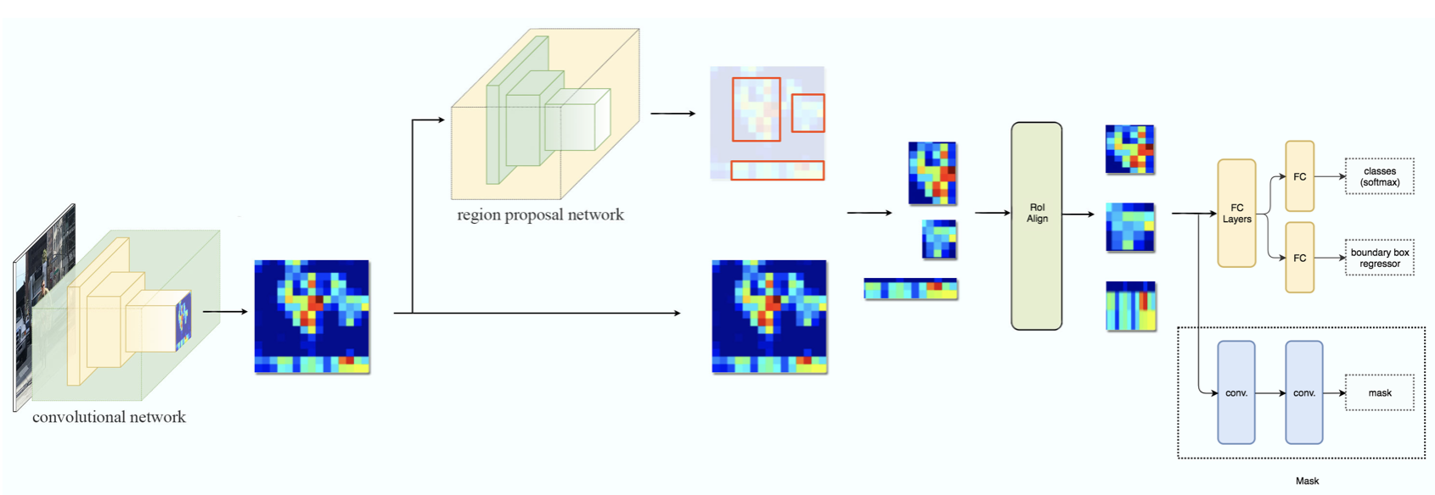
A Closer Look at Mask R-CNN
Faster R-CNN
Object Detection Branch
Segmentation Branch
Mask R-CNN
Faster R-CNN
- Outputs classification with bounding boxes
Mask R-CNN
Adds segmentation
Introduces Regions of Interest

Slide 6
Mask R-CNN – Backbone/Encoder (convolutional base)
Faster R-CNN
Object Detection Branch
Segmentation Branch
Convolutional Network
Pyramid Structure
Mask R-CNN
Backbone/Encoder:
Captures shape information and drops fine-details
Pyramid-like structure
Skip Connections
`
Encoding
FashionDataSet uses ResNet50 as backbone

Slide 7
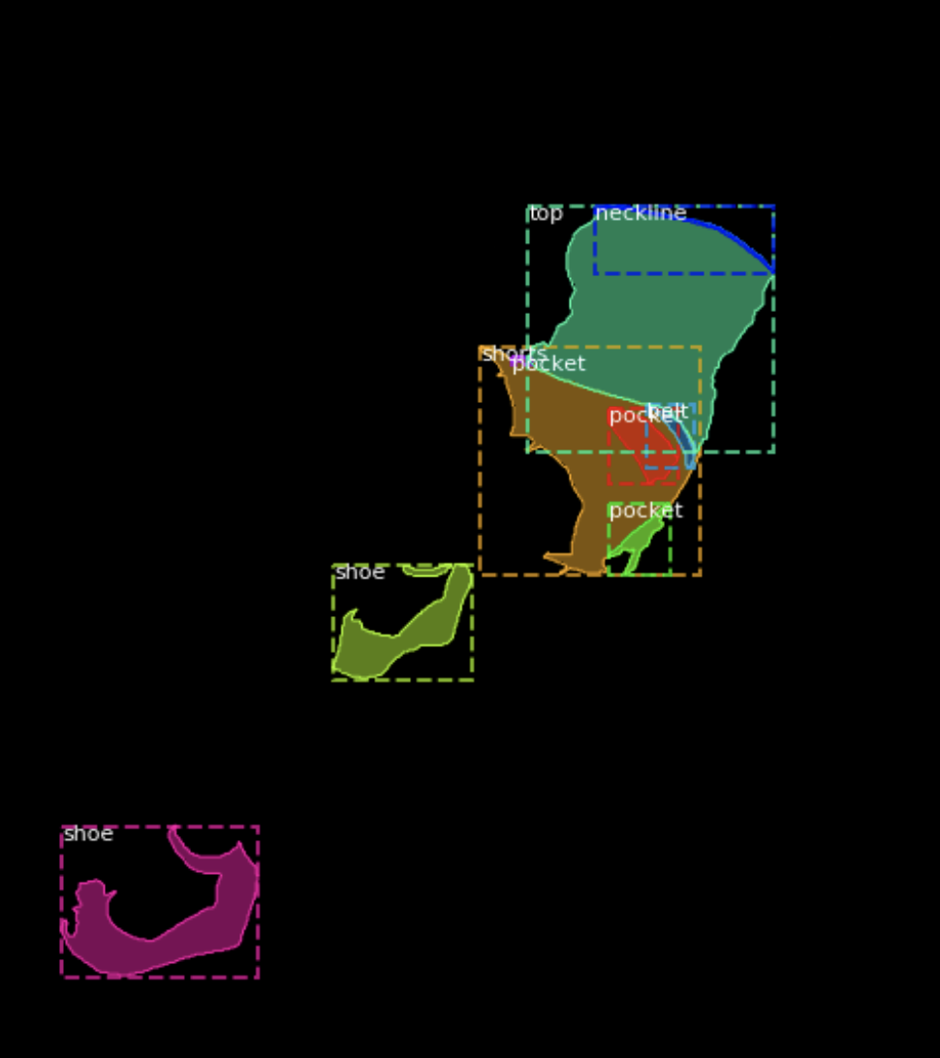
Pyramid Structure
Encoder
The encoder translates image into shapes sacrificing surface details
Decoder
The decoder translates the encoded shapes into a viewable image
Each layer of pyramid changes dimensions that capture features of different sizes
Encoder shares shape information at different scales to improve masking of objects with varying sizes
Encoding
`

Slide 8
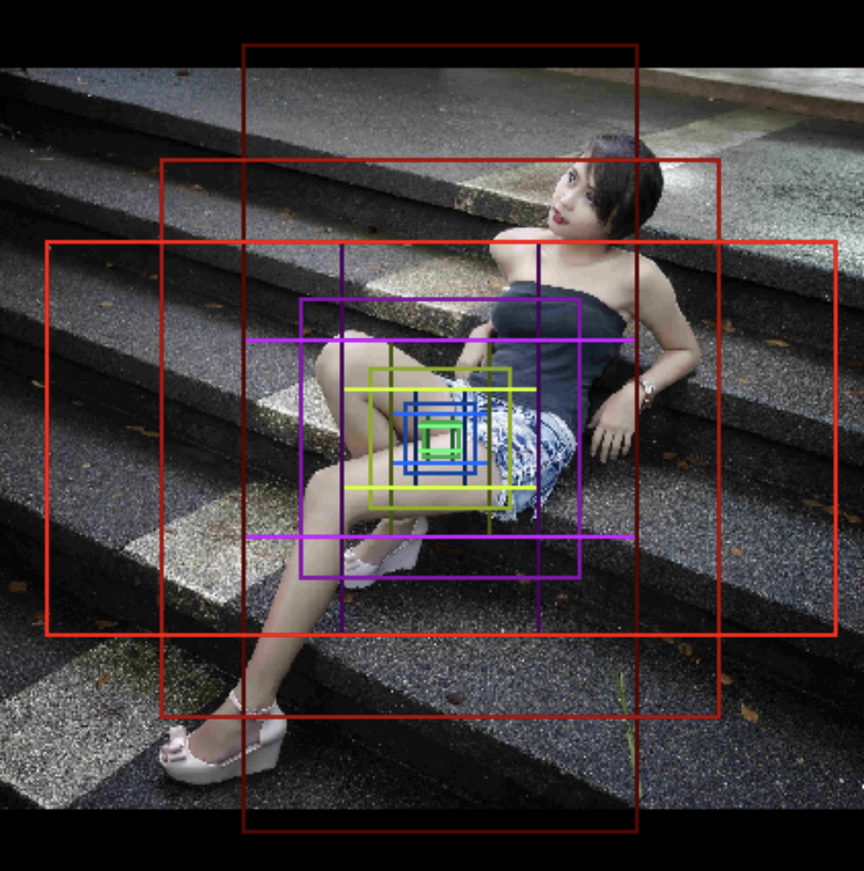
Mask R-CNN – RPN – Region Proposal Network
Faster R-CNN
Object Detection Branch
Fashion DataSet
262k regions per image
5 sizes and 3 aspect ratios
Segmentation Branch
Mask R-CNN
Region Proposals:
Faster R-CNN contribution
Defines possible bounding boxes
Regions proposed at each pyramid level
Various aspect ratios and sizes

Slide 9
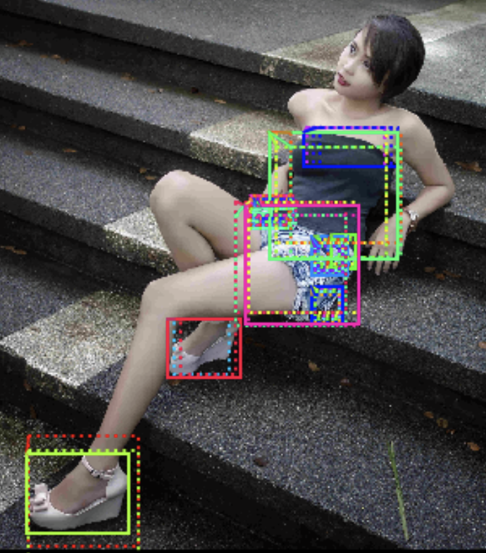
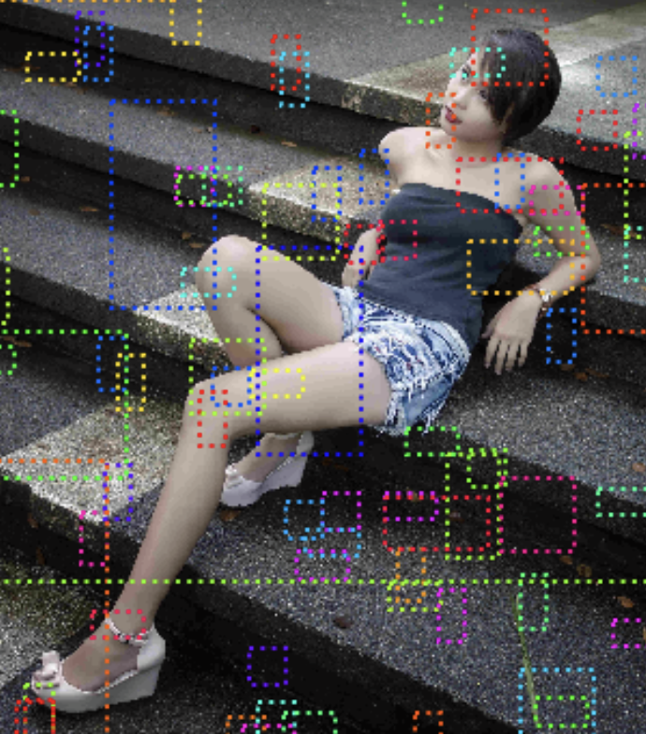
Mask R-CNN – Region Proposals
Positive Scores
Faster R-CNN
Object Detection Branch
Segmentation Branch
Mask R-CNN
Negative Scores
Here, we see 52 positive regions.
Each proposed region is scored

Slide 10
Mask R-CNN – ROI Align – Refined Selections
Faster R-CNN
Mask R-CNN Output
Classification
Bounding Box
Segmentation Mask
Object Detection Branch
Segmentation Branch
Mask R-CNN
Top scoring regions sent to:
object detection branch (Faster R-CNN)
segmentation branch (Mask R-CNN).
3 network outputs (class, box, mask)
Segmentation processed in parallel to classification

Slide 11
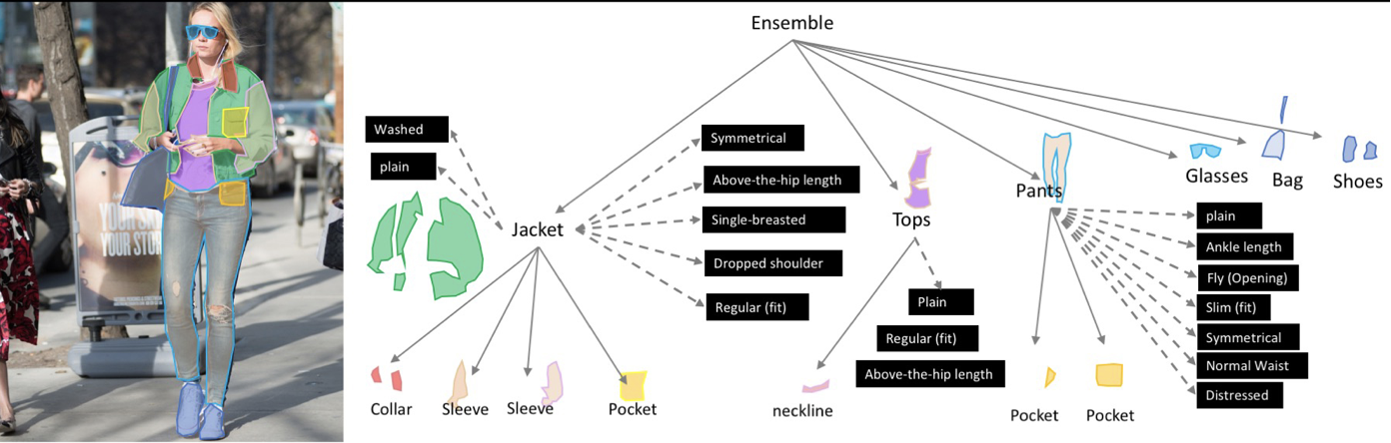
Fashion Segmentation – Experimentation with Mask RCNN
2019 Fashion Kaggle Competition
Dataset of 45k images and 300k annotations
Labels include fine details of clothing items in 46 classes
https://www.kaggle.com/c/imaterialist-fashion-2019-FGVC6/overview

Slide 12
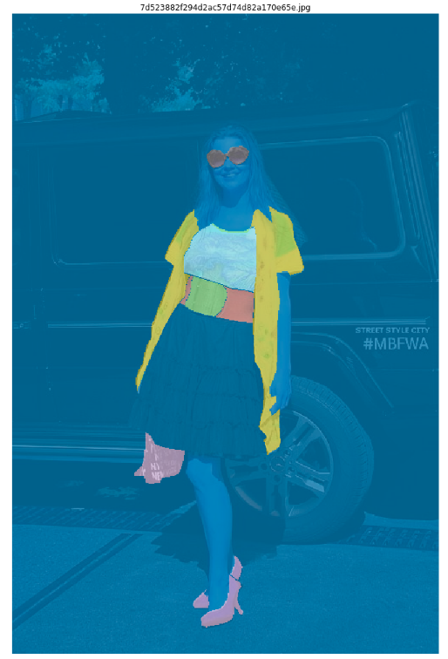
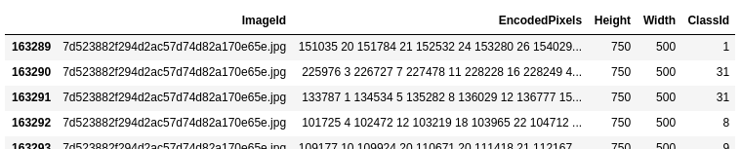
iMaterialist Dataset
Exploratory Data Analysis
Kaggle Data
Matterport Mask-RCNN
Keras/Tensorflow
Images
Train CSV
DataSet
Train
Classes CSV
Dataset of ~45K images with total of ~300k annotations
Annotations provided in Run-Length Encoding(RLE) Format
Figure: (L) Sample dataframe from iMaterialist Dataset , (R) Corresponding image with decoded annotation masks
The ClassId is obtained by concatenating both predicted apparel object index and predicted attributes' indices for this object. (e.g 6_28_77 → Category: Pants ; Attributes: Bell, Leopard)
Fine-grained attributes were ignored for this project

Slide 13
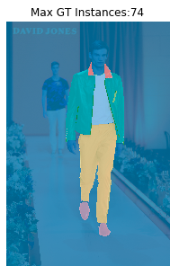
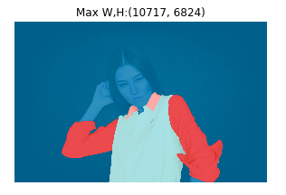
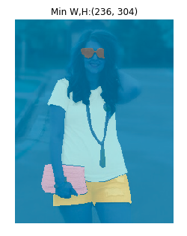
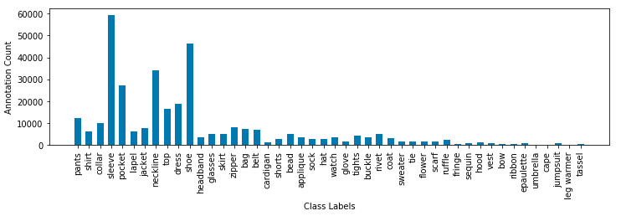
iMaterialist Dataset
Dataset in numbers
Training Images | 45625
Test Images | 3200
Training Annotations (GT) | 333415
Max GT Instance/ Image | 74
Mean GT Instance/Image | 7.3
Max Dimensions (W,H) | (10717,6824)
Min Dimensions (W,H) | (236, 304)
Categories | 46
Max Category Count | 59452 (sleeve)
Min Category Count | 112 (leg warmer)
Median Category Count | 3212
Figure: Sample images from iMaterialist Dataset with extremas
Figure: Distribution of annotation masks in dataset by categgory

Slide 14

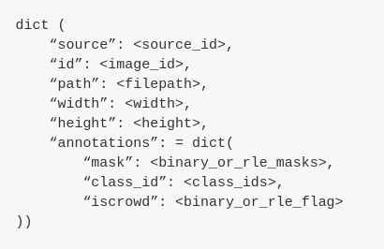
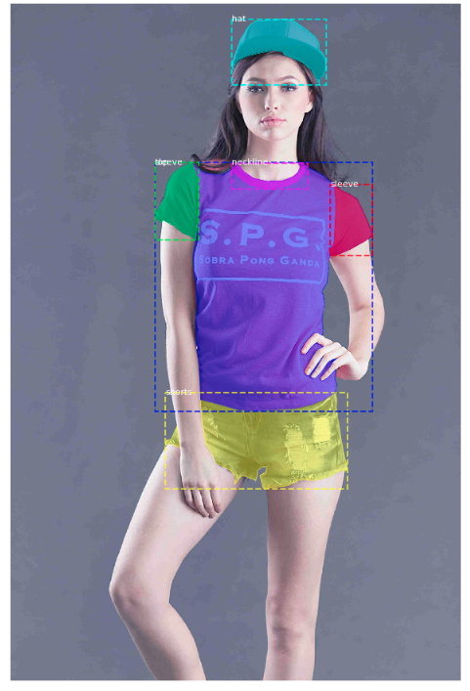
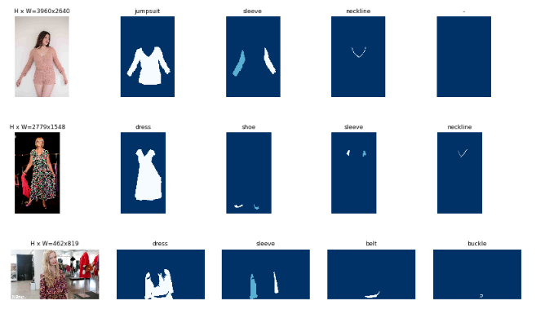
Fashion Segmentation
Matterport Mask RCNN Implementation
Kaggle Data
Matterport Mask-RCNN
Keras/Tensorflow
Images
Train CSV
DataSet
Train
Classes CSV
Mask-RCNN Matterport implementation
Provides COCO-style Dataset structure to import the custom data
Dataset class used for image handling and training in Keras
Sample images with mask instances after loading into COCO-style dataset
https://www.kaggle.com/c/imaterialist-fashion-2019-FGVC6/overview

Slide 15
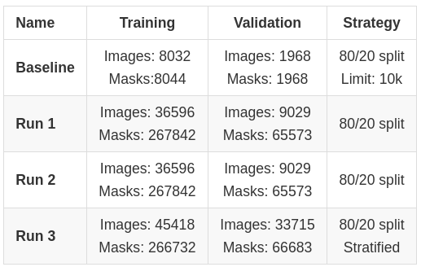
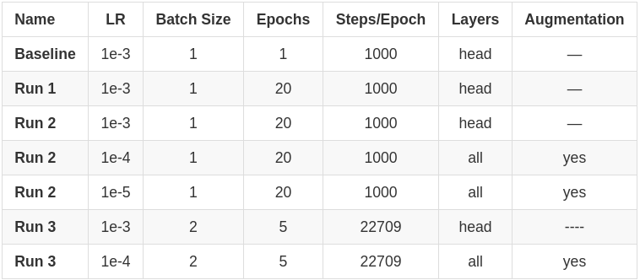
Fashion Segmentation
Training Summary
Kaggle Data
Matterport Mask-RCNN
Keras/Tensorflow
Images
Train CSV
DataSet
Train
Classes CSV
Dataset Usage: 80/20 split
Hyper-parameters Tuning
SGD Optimizer with variable learning rate
NVIDIA GPU GTX 1070

Slide 16
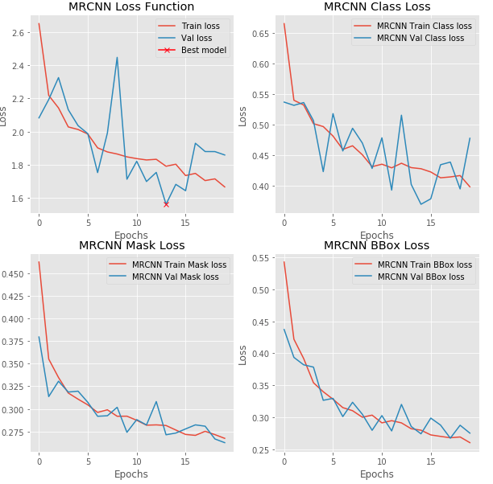
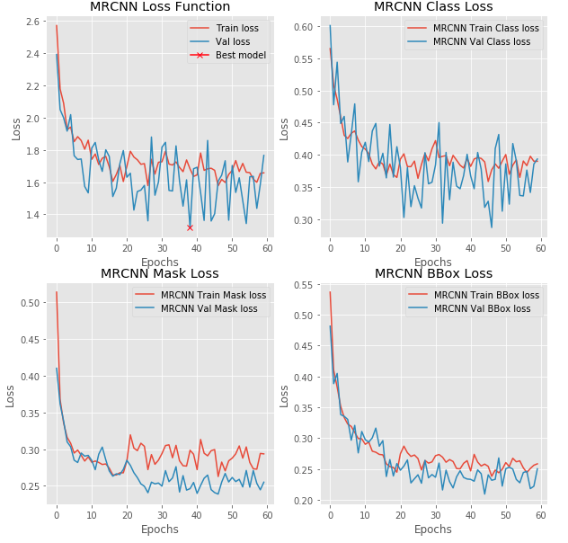
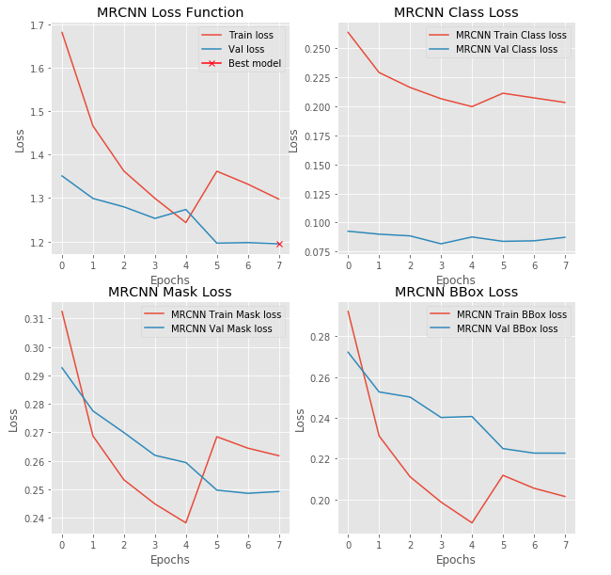
Fashion Segmentation
Training Losses
Kaggle Data
Matterport Mask-RCNN
Keras/Tensorflow
Images
Train CSV
DataSet
Train
Classes CSV
Run 1
Run 2
Run 3

Slide 17
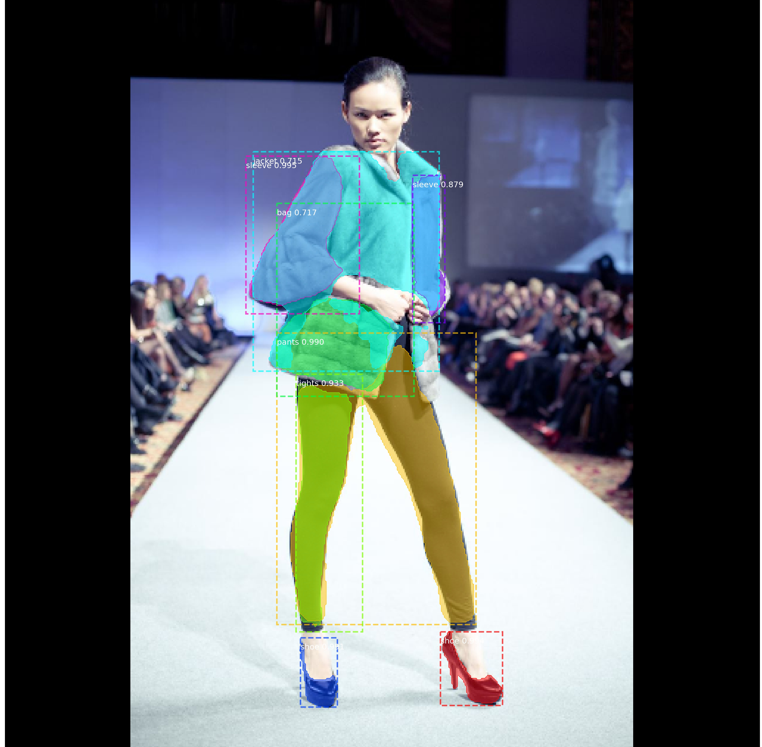
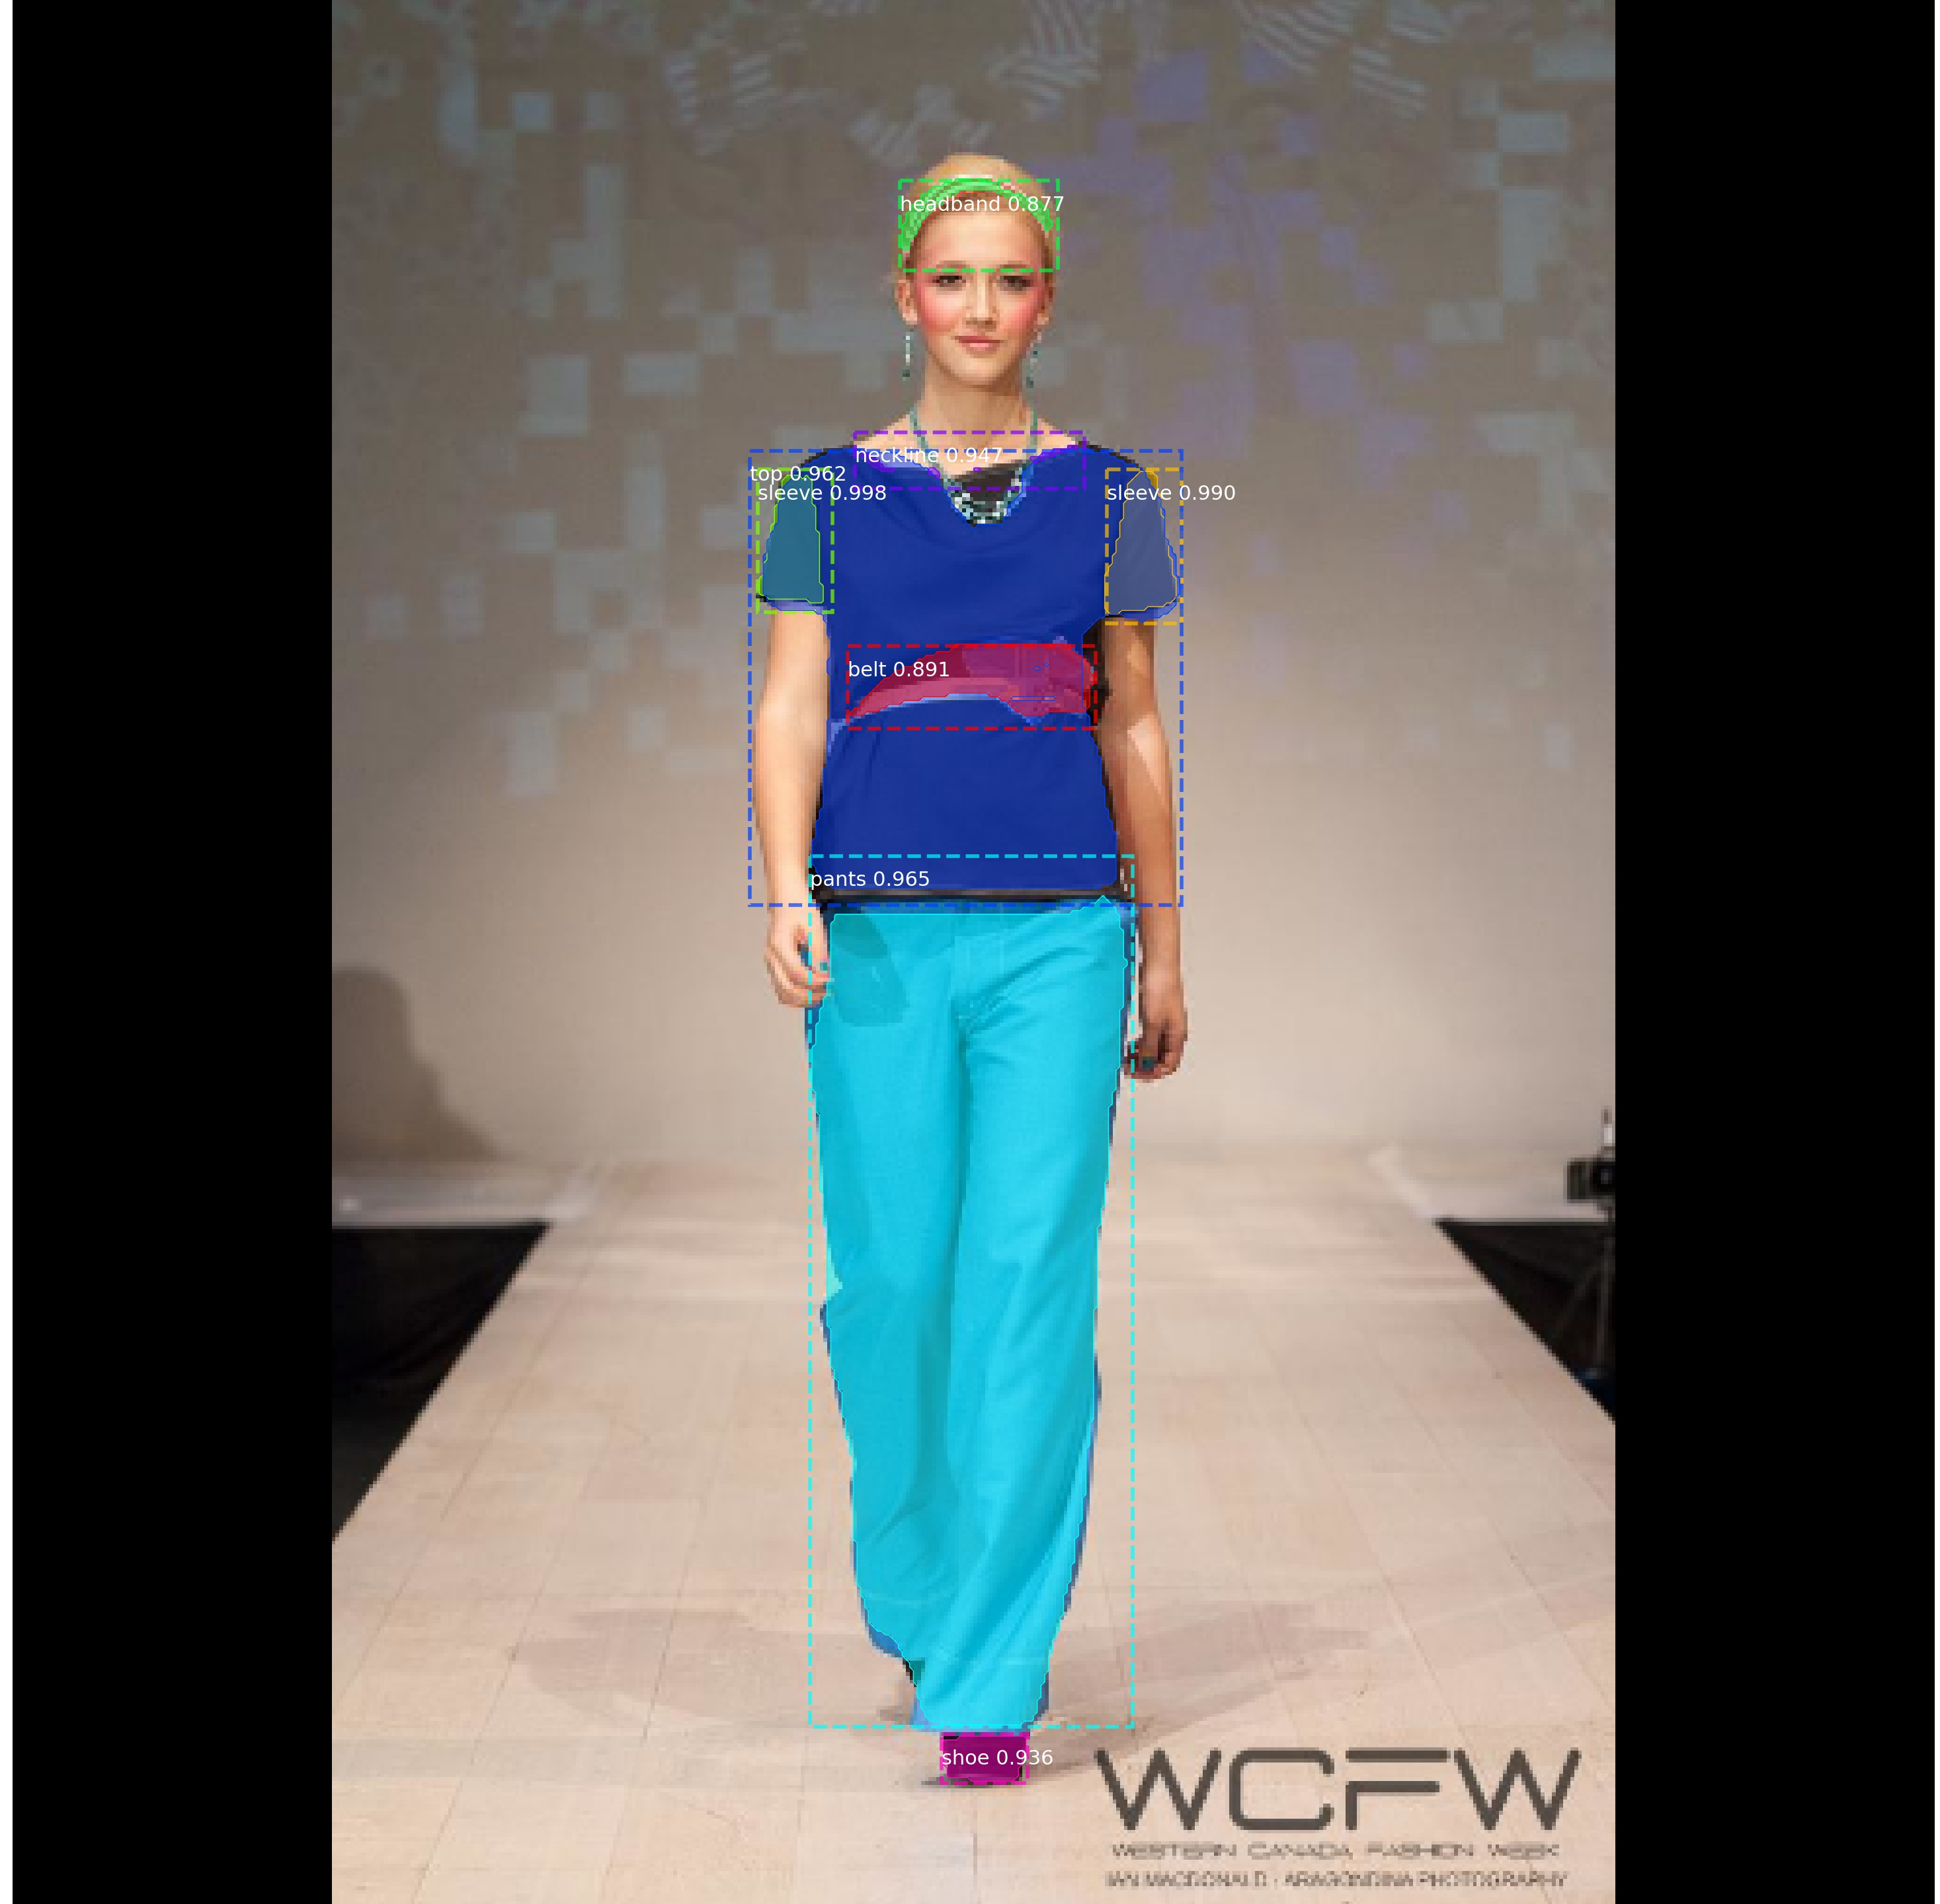
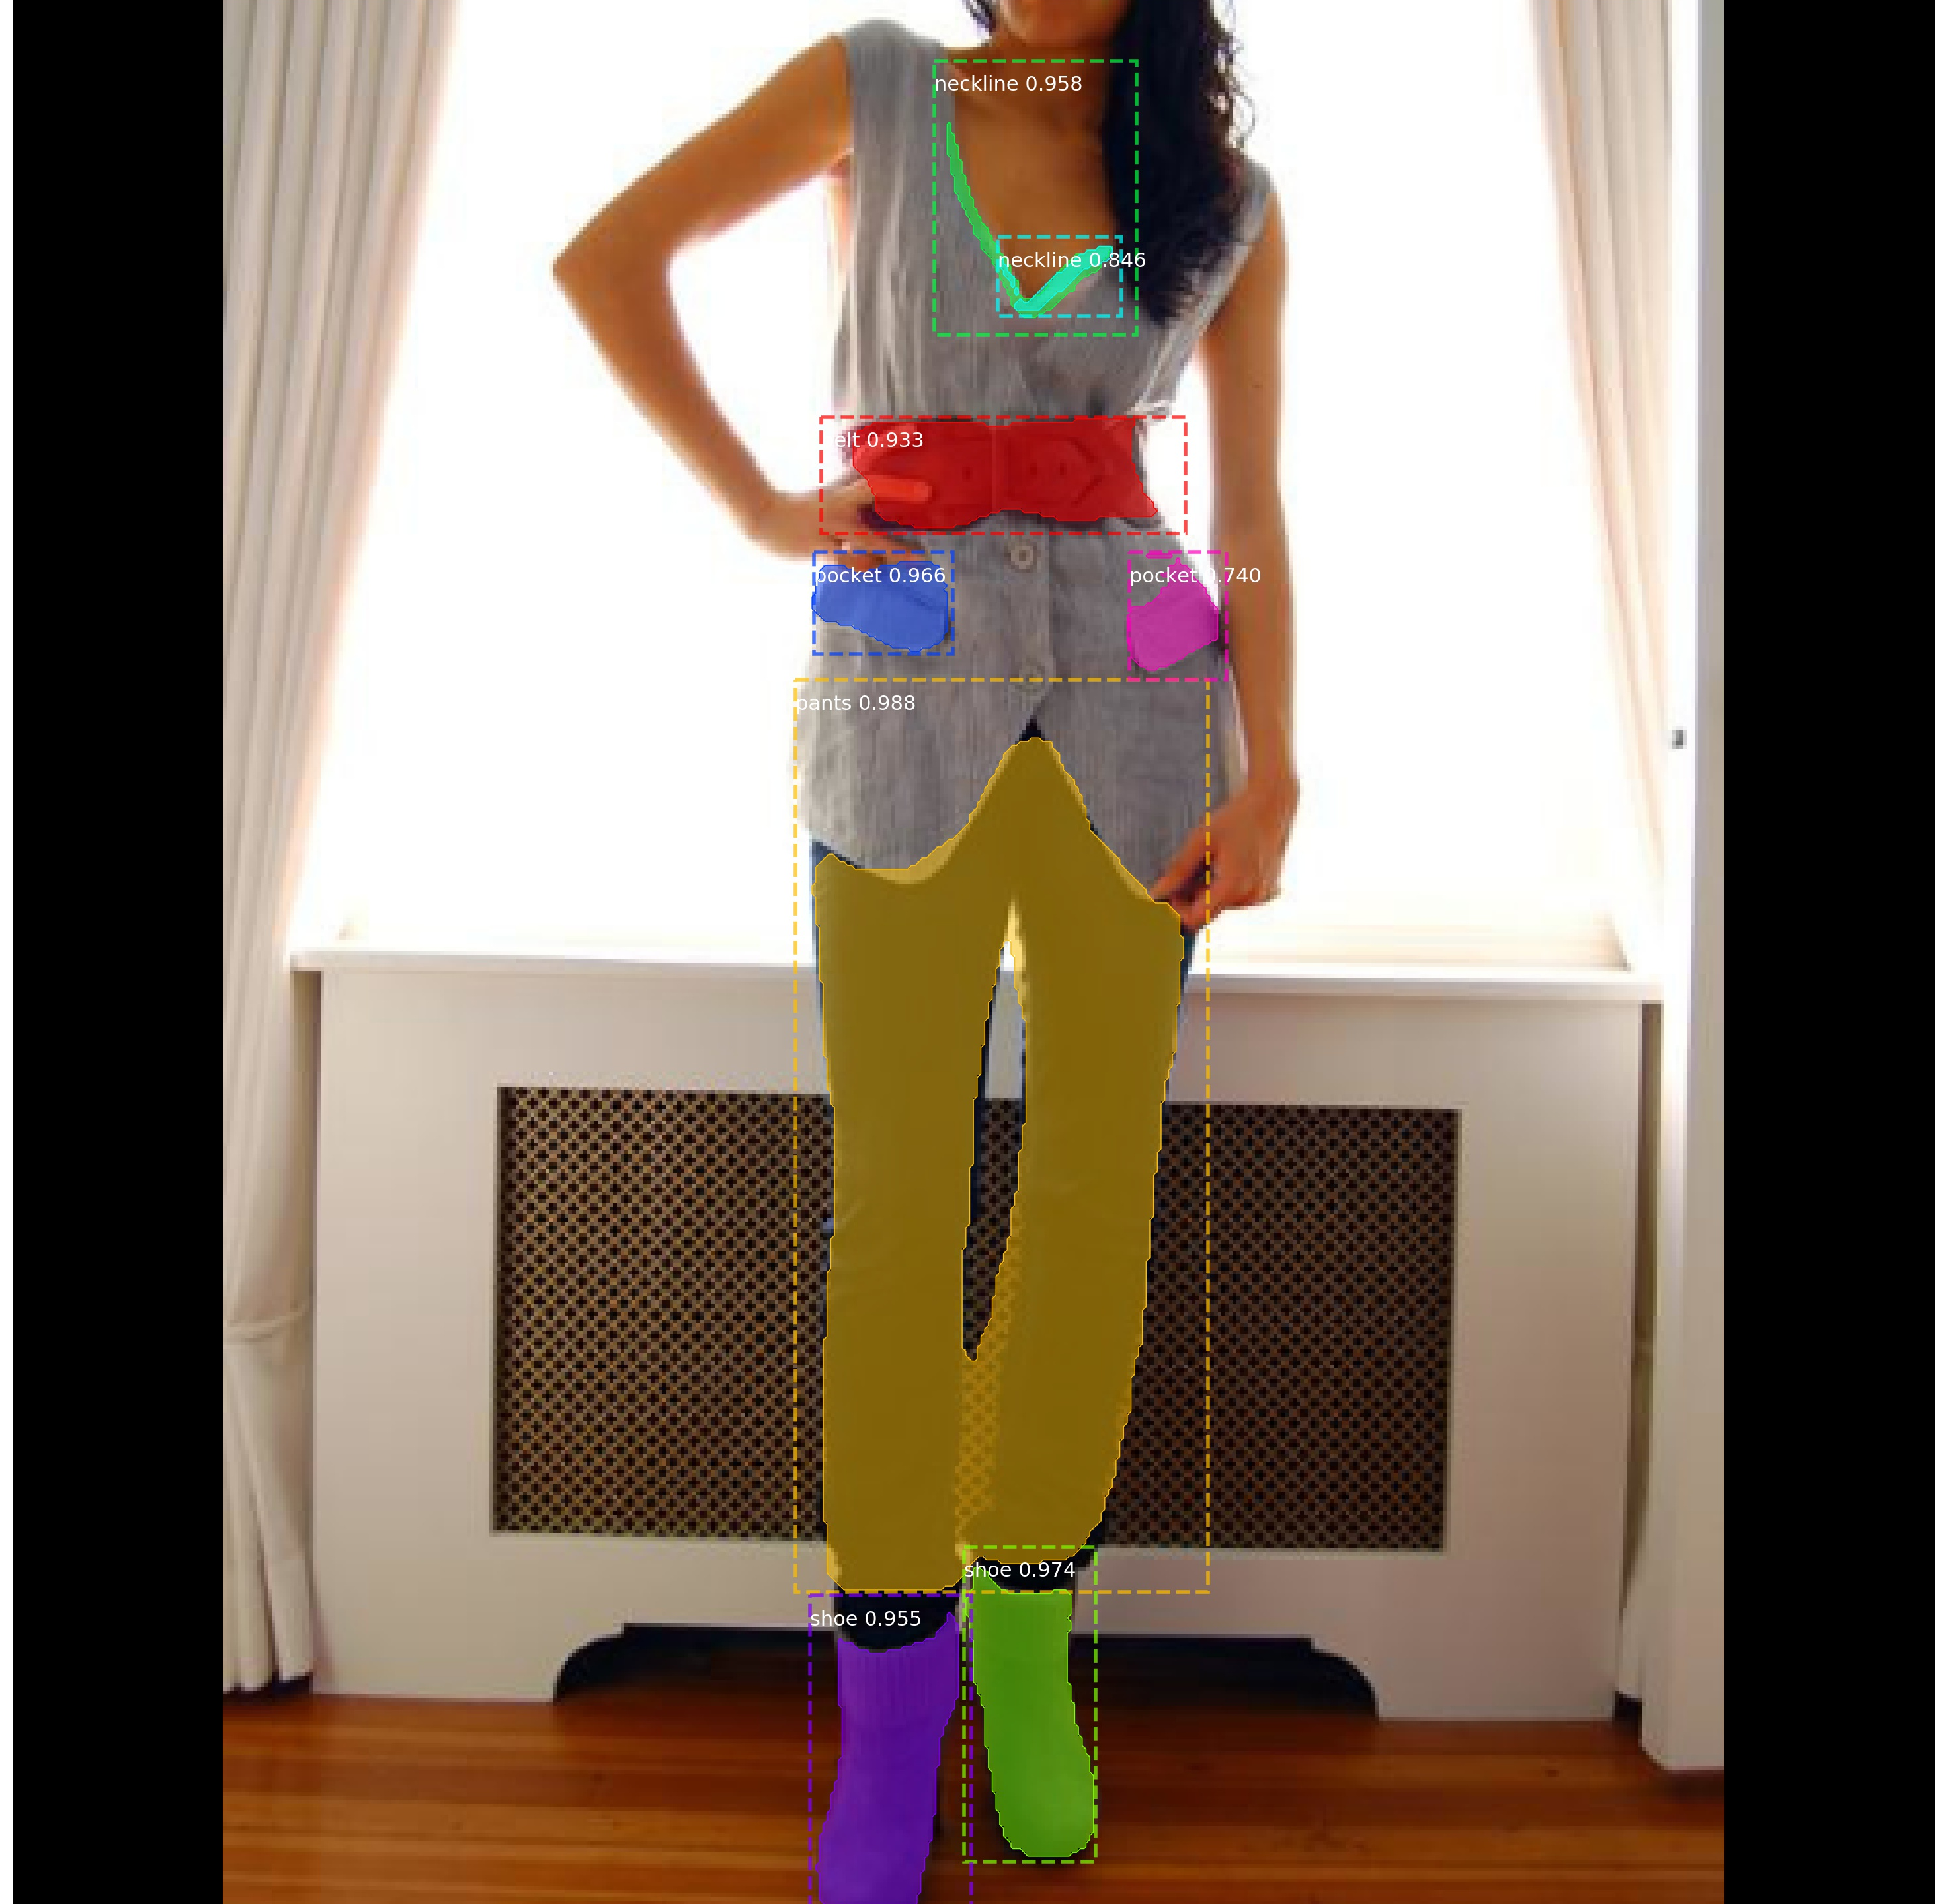
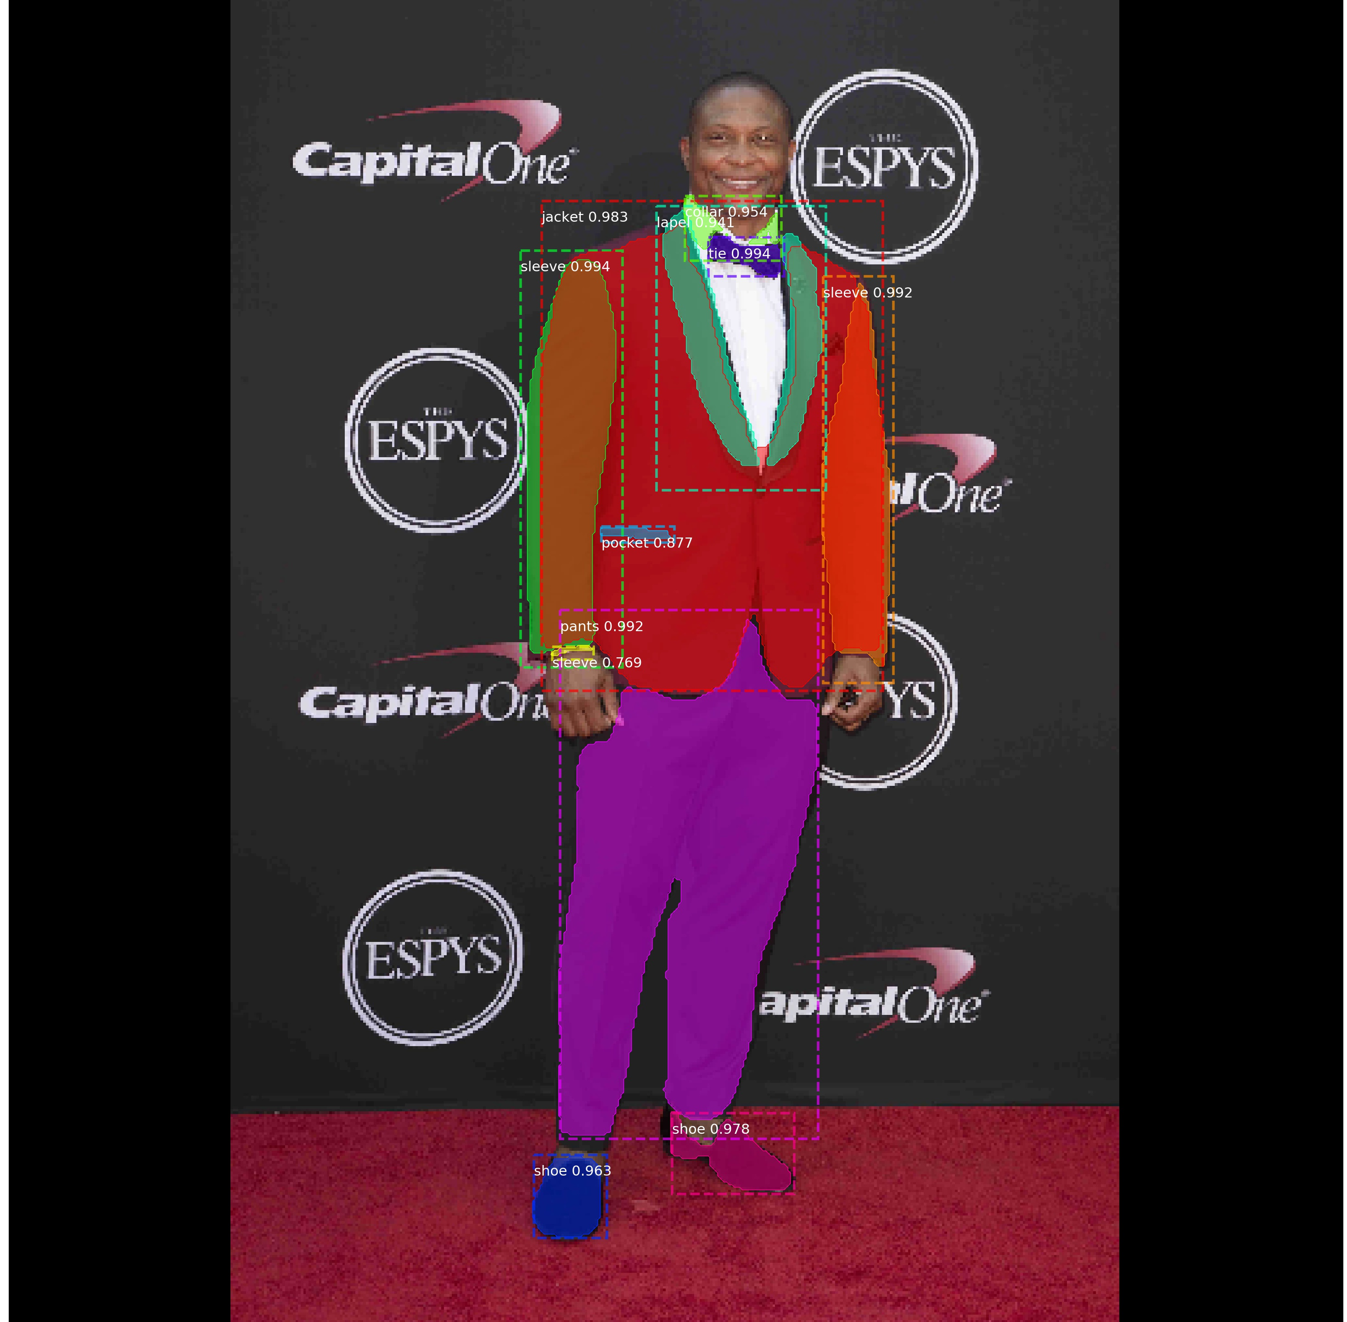
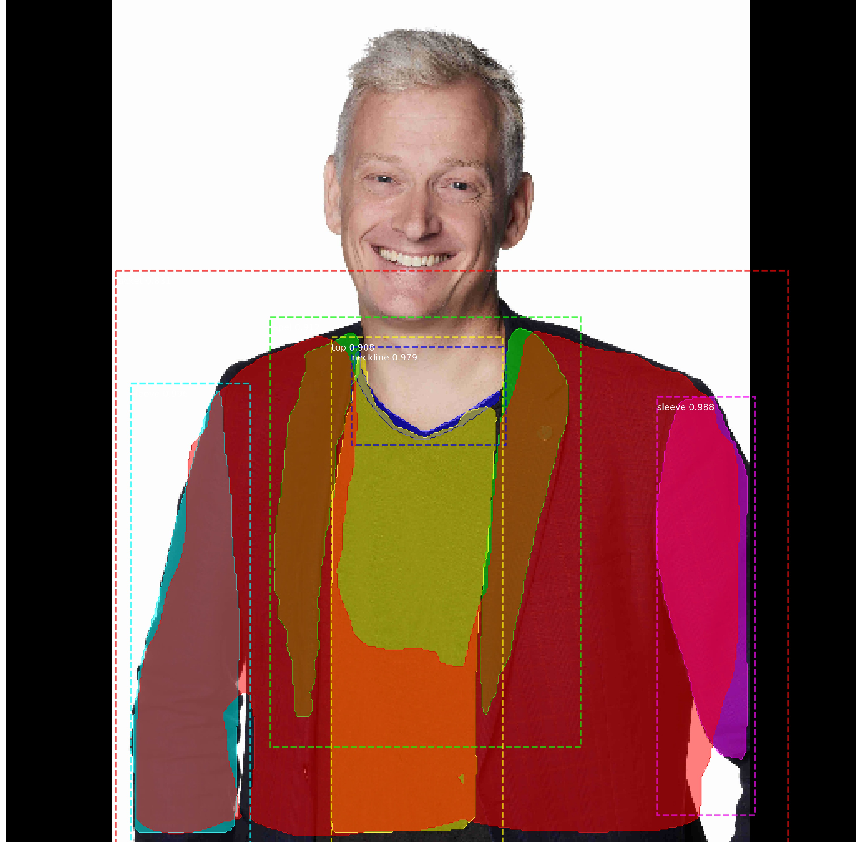
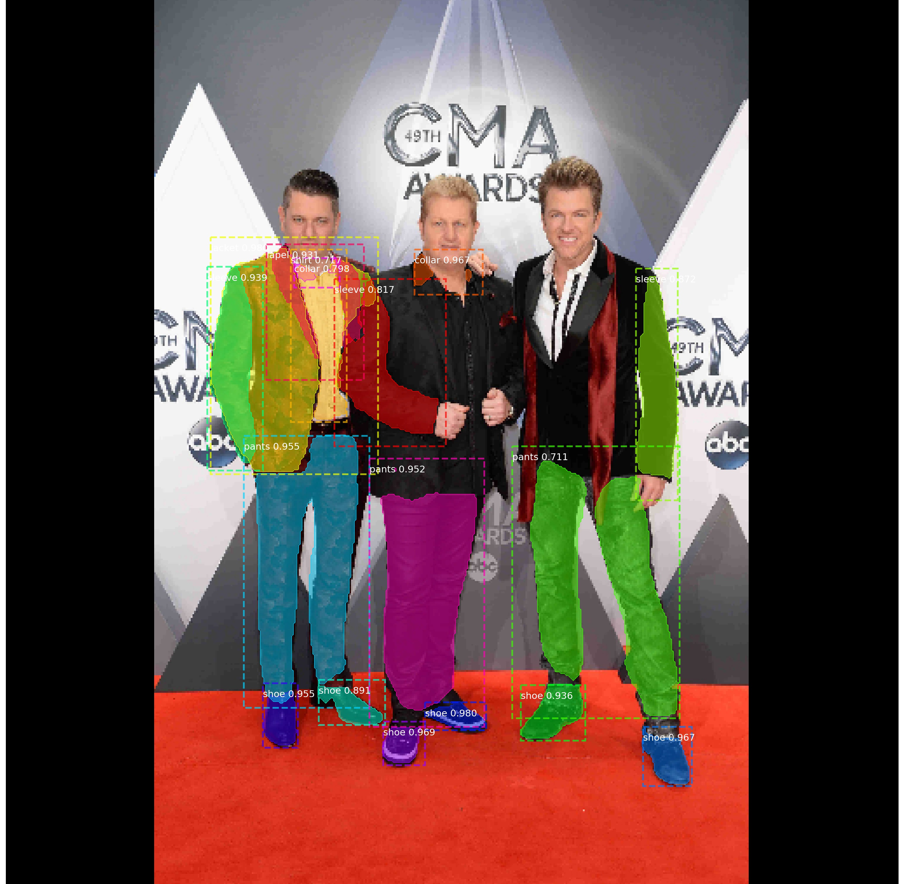
Fashion Segmentation
Results

Slide 18
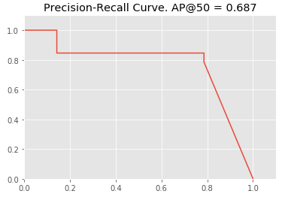
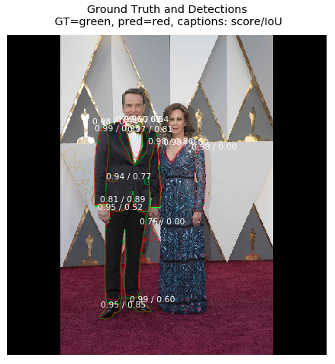
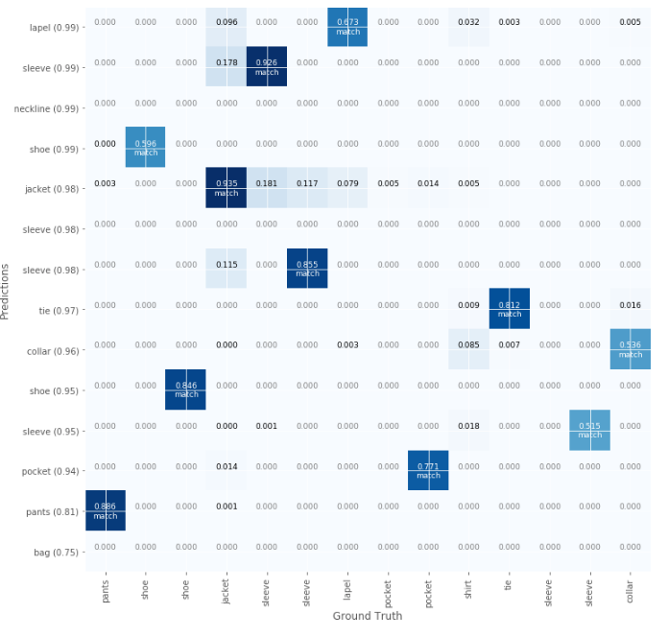
Fashion Segmentation
Results
Confusion Matrix
Sample Image with ground truth and predictions, and scores

Slide 19
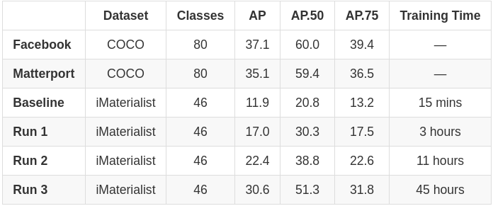
Fashion Segmentation
Evaluation Metrics
IoU(A,B)= A∩B / A∪B
AP calculated over range from 0.5 to 0.95 with a step size of 0.05: (0.5, 0.55, 0.6, 0.65, 0.7, 0.75, 0.8, 0.85, 0.9, 0.95)
Reported numbers for our model are mean Average Precision values (mAP) over a batch of 100 random images from validation dataset
Average Precision values improve with training the model over the entire dataset

Slide 20
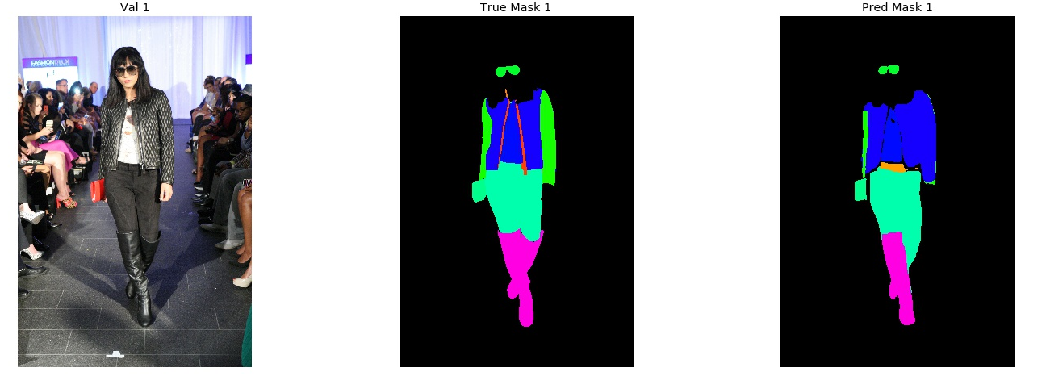
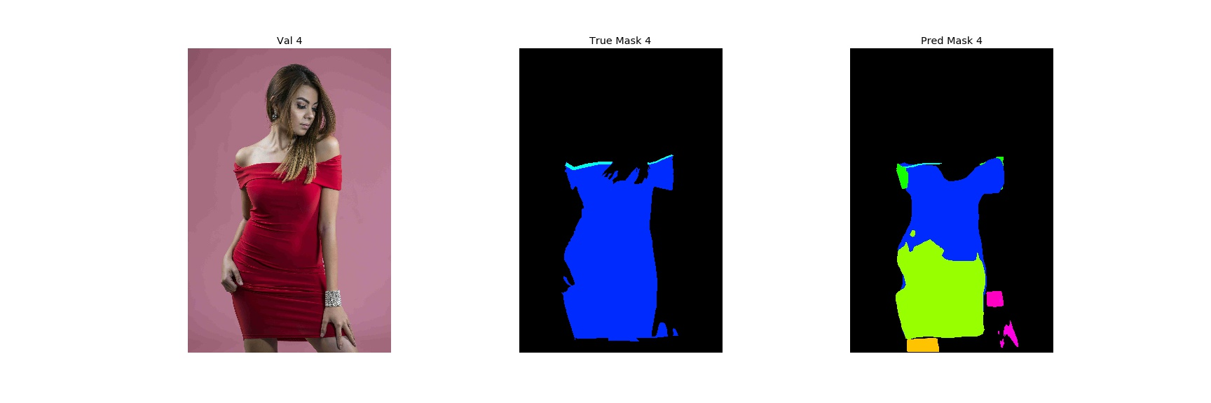
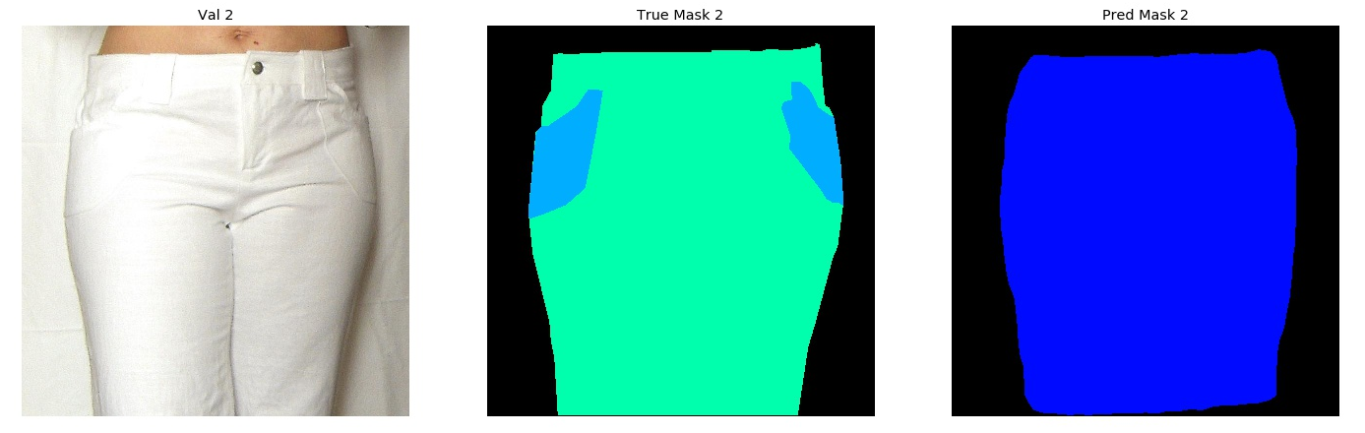
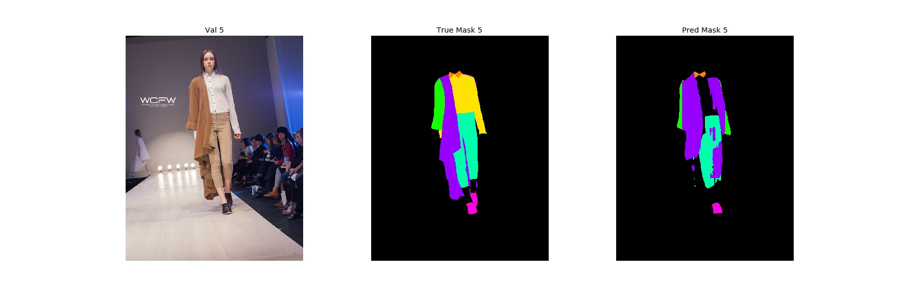
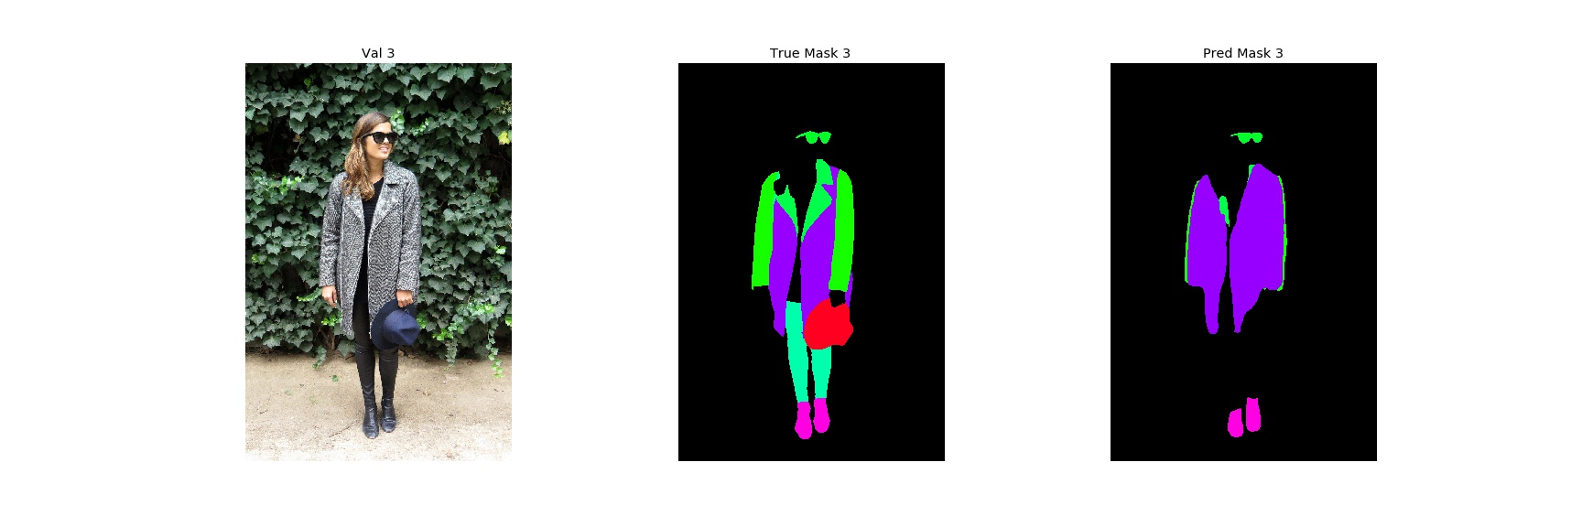
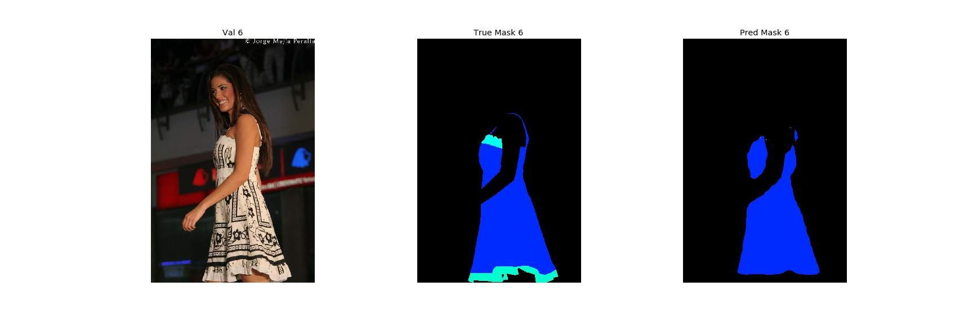
Fashion Segmentation
Predictions as semantic masks

Slide 21
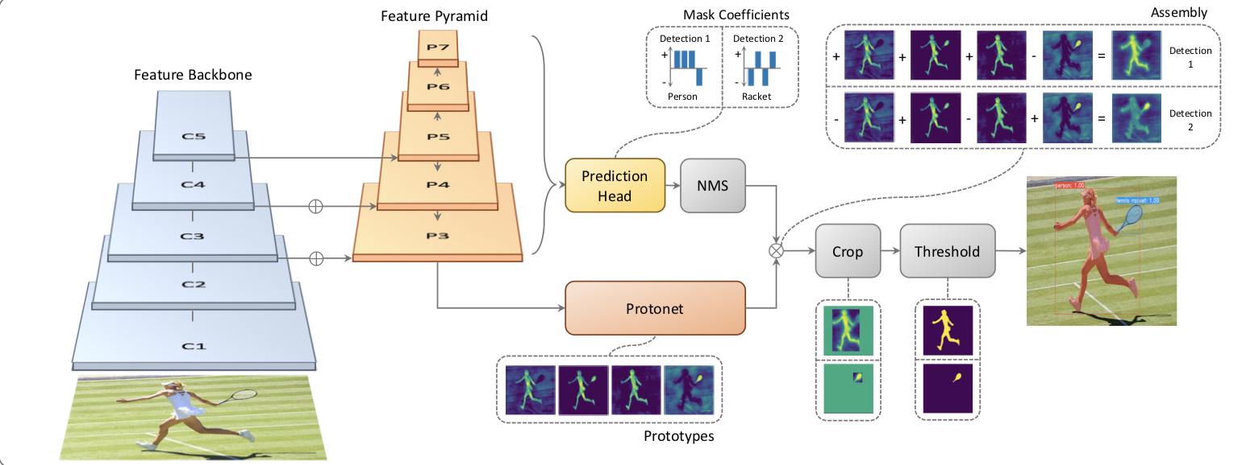
YOLACT (You Only Look At CoefficienTs)
Real-time speeds
Learns a “prototype” mask for a dataset.
Image values determine coefficients applied to prototype mask
Focus on speed, not accuracy
http://openaccess.thecvf.com/content_ICCV_2019/papers/Bolya_YOLACT_Real-Time_Instance_Segmentation_ICCV_2019_paper.pdf

Slide 22
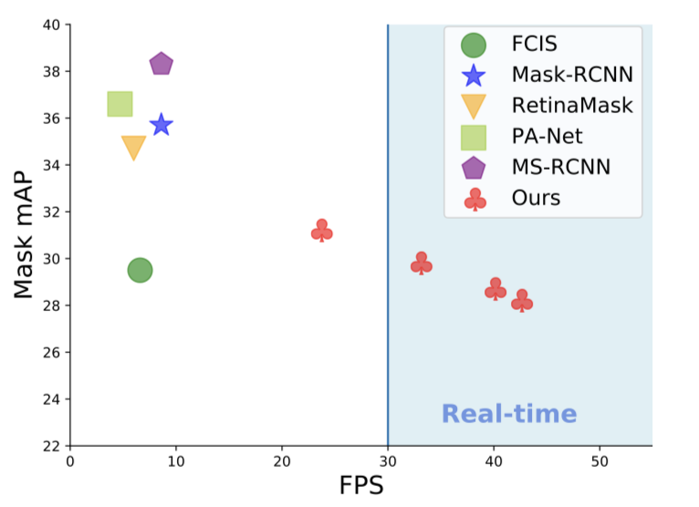
YOLACT (You Only Look At CoefficienTs)
Remarkable speed increase!
Mask RCNN
Employs new approach to masking
Learns coefficients of a transformation rather than mask
Transforms a ‘prototype’ mask into a segmentation with the coefficients.
YOLACT
YOLACT

Slide 23
Mask R-CNN – Lessons Learned
Start with Pre-Implemented Model Starting with a pre-created implementation of an architecture is imperative. Implementing a model based on an academic paper is a challenge.
Use Transfer Learning improves model quality and decreases needed training time
Plan Preparation Time A sizeable portion of the effort was on understanding data and preparing for training. This part of the project should be broken into details steps.
Good Hardware Helps Understanding the hardware and using capable hardware are important to ensure reasonable training speeds.
Meta-Parameter Tuning is Hard Meta-parameter tuning is as artist as it is scientific. The number of possible setting combinations is limitless. Some knowledge of the settings and their impact is necessary to avoid wasting time on ineffective changes.

Slide 24
Mask R-CNN – Improvements
Regularization Introduce regularization and further augmentation into the model and training process so to avoid performance plateau and improve results.
Augmentation Review augmentation to ensure effective use.
Performance Improvements Consider ways to improve training speed: using gray-scale images, smaller image sizes.
Expand Model Capacity Add fine-details included in dataset which were removed for project.
Use Different Transfer Learning Sources Try training model with different bases (e.g. ResNet152)
YOLACT Implement YOLACT for real-time segmentation

Slide 25
BACKUP

Slide 26
Resolution
Semantic Meaning
Encoding
`

Slide 27
Encoding
`

Slide 28

Pyramid Structure – Pre-Trained Encoder
Major benefit of Encoder Structure
Pre-Trained Encoder
Plugs into a decoder.
Avoids training from scratch.
Decoder
Trained on specific dataset.
Encoder can still share features from various scales. Decoder design must take encoder dimensions into account.
e.g.
ResNet101
Encoding

Slide 29
Encoder Architecture
Most segmentation models use an encoder structure
Details shared during decoding
Input:
image
Output: Mask
Encoding
Encoder
Decoder
Modularity:
A benefit of this structure is that the encoder and decoder portions can be separated.

Slide 30
Encoder Architecture
Most segmentation models use an encoder structure
Input:
image
Pre-Trained Network
Output: Mask
Encoding
Encoder
Decoder
Pre-Trained Networks:
ResNet, VGG, …

Slide 31
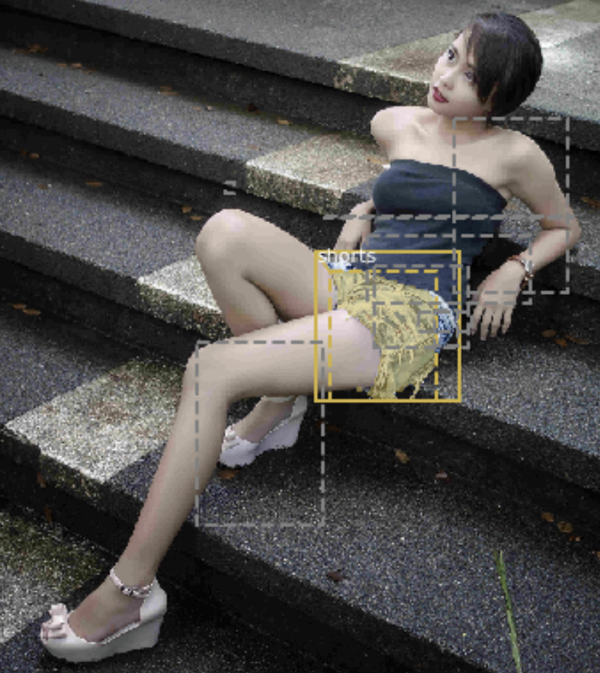
Mask R-CNN – ROI Align – Refined Selections
RPN Results
Faster R-CNN
Object Detection Branch
Segmentation Branch
Mask R-CNN
ROI Alignment
REMOVE
Selected regions aligned to same size before feeding into final layer

Slide 32
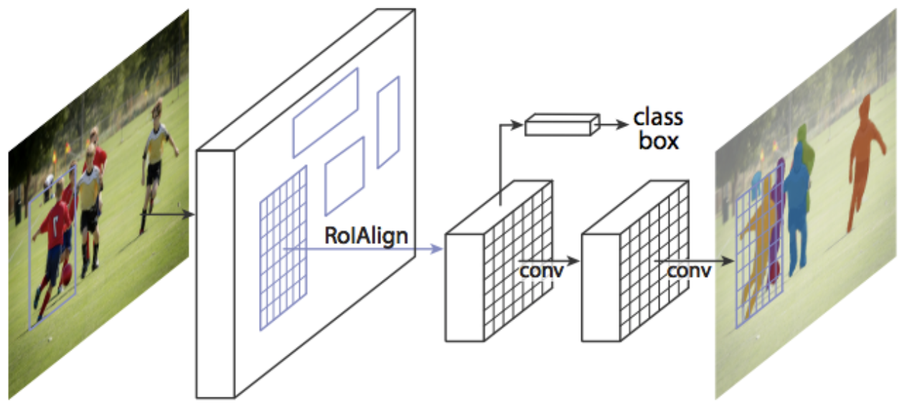
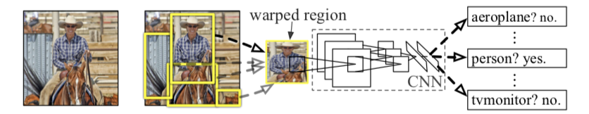
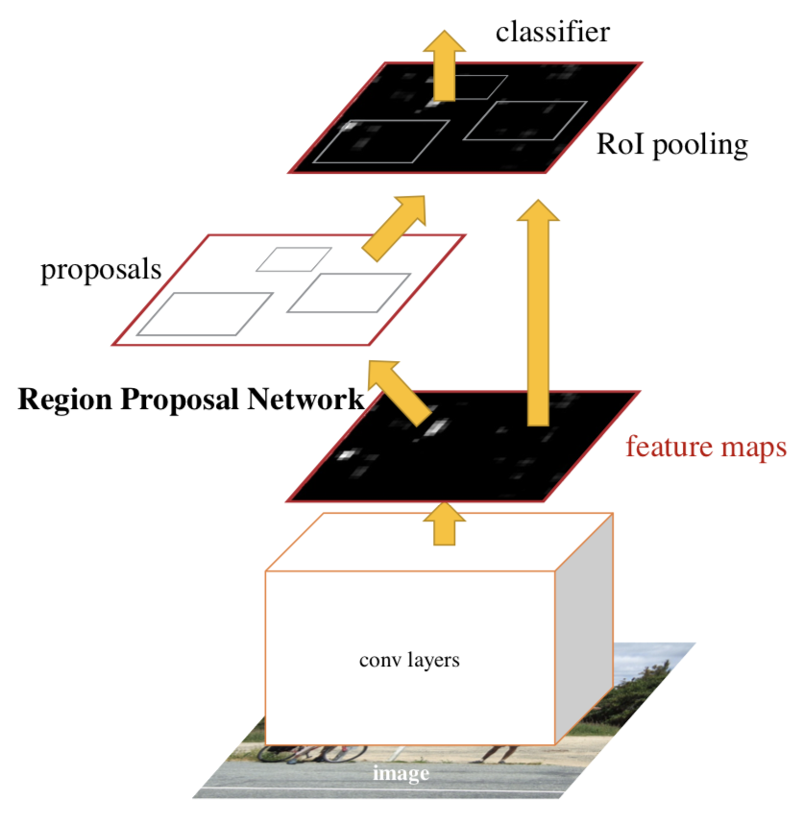
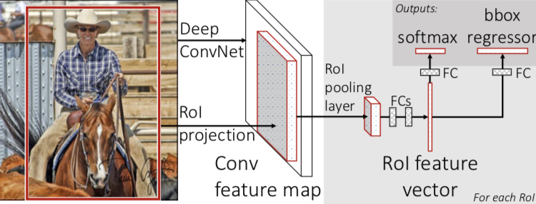
Mask R-CNN - Evolution
Introduced concept of region proposals
Adds Instance Segmentation
3 outputs:
Classification
Bounding Box
Instance Segmentation
(near real-time 5fps)
Single network for features, classification and bounding boxes
Added Region Proposal Network
(near real-time 5fps)
PASCAL VOC (R-CNN)
54%
66%
78%
Oct 2014
R-CNN
Sep 2015
Fast R-CNN
Jan 2016
Faster R-CNN
Jan 2018
Mask R-CNN
https://arxiv.org/pdf/1311.2524.pdf
https://arxiv.org/pdf/1504.08083.pdf
https://arxiv.org/pdf/1506.01497.pdf
https://arxiv.org/pdf/1703.06870.pdf
https://blog.athelas.com/a-brief-history-of-cnns-in-image-segmentation-from-r-cnn-to-mask-r-cnn-34ea83205de4

Slide 33
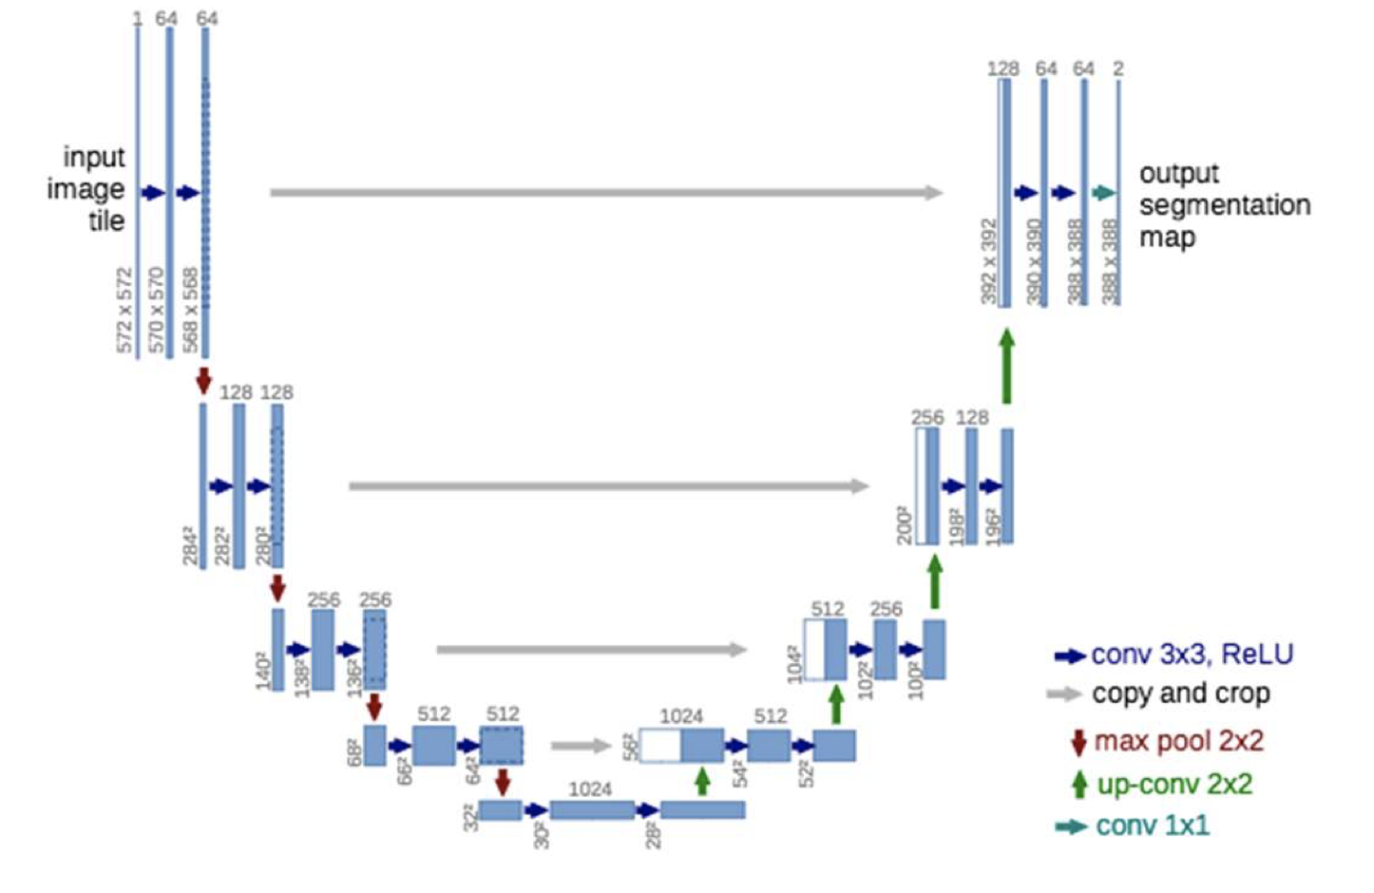
Encoder Modularity Example
Build Steps:
Isolate Unet decoder
Import Resnet pretrained network
Connect Layers
Adjust Image scaling for training
Train
Adjust image scaling for inference
ResNet
Unet
Input
Block 1
Block 2
Block 3
Block 4
Block 5
Encoder

Slide 34
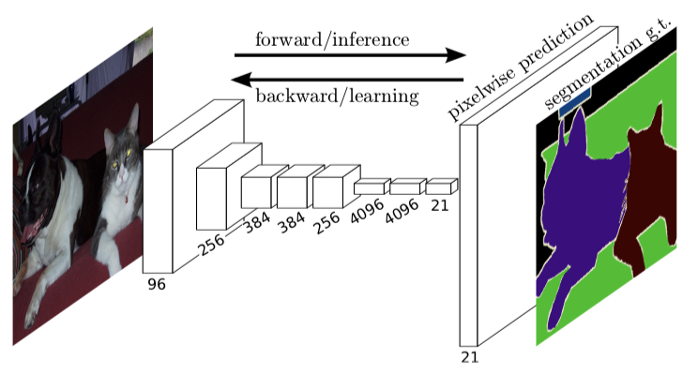
FCN (Fully Convolutional Network)
Early segmentation architecture
Uses CNN’s throughout
https://arxiv.org/pdf/1605.06211v1.pdf

Slide 35
UNet
Uses skip connections to maintain detail in decoder
Used in medical imaging where detail is important
https://arxiv.org/pdf/1505.04597.pdf

Slide 36
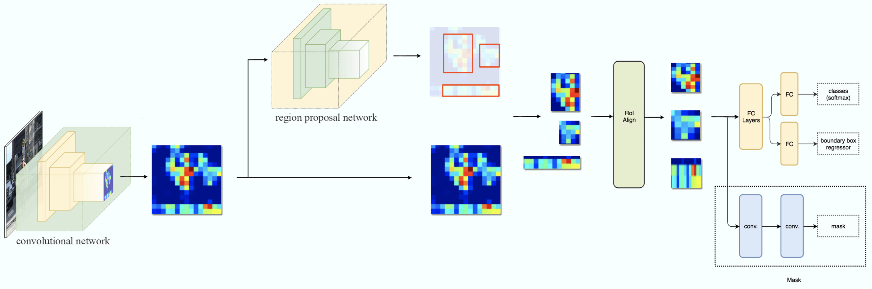
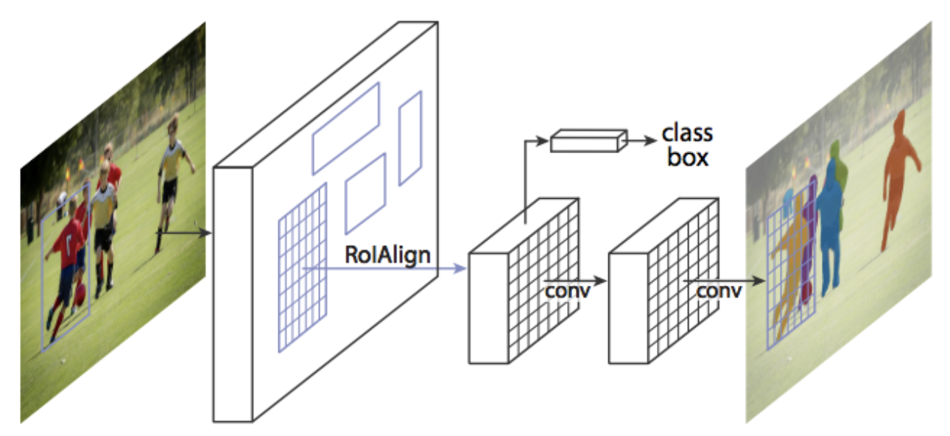
Mask R-CNN
Iteration of R-CNN evolution
Adds segmentation to previous iterations
Includes bounding boxes and instance segmentation
https://medium.com/@jonathan_hui/image-segmentation-with-mask-r-cnn-ebe6d793272
https://arxiv.org/pdf/1703.06870.pdf

Slide 37
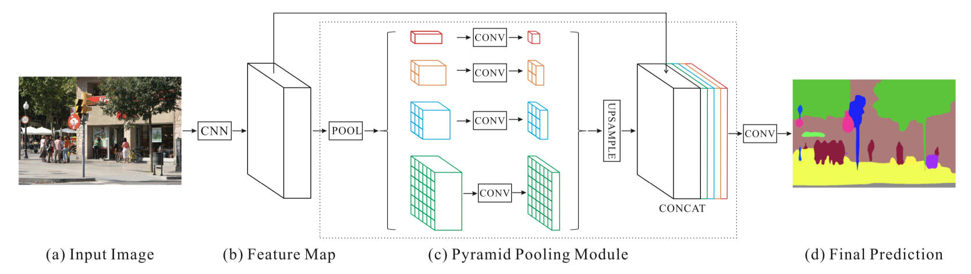
PSPNet (Pyramid Scene Parsing Network)
Detects objects of varying size using Pyramid of convolutions
Classifies based on overall image context
A single PSPNet yields the new record of mIoU accuracy 85.4% on PASCAL VOC 2012 and accuracy 80.2% on Cityscapes.
https://arxiv.org/pdf/1612.01105.pdf

